Slide 1
Chlorophyll-a Gap-Filling Using U-Net
Yifei Hang
Notes:
I’m, intern with eli to address the Chl gap filling task using ml algorithms
Present about my work on using a specific model called unet

Slide 2
Problem: Missing CHL data
Satellite remote sensing: unable to penetrate through clouds
Traditional solution: interpolation & geospatial
Our solution: machine learning (neural networks)
Goal: train a neural network with comparable performance, explore the benefit of incorporating environmental variables
Notes:
Why chl and why this gap filling task?
Key indicator for ocean productivity, supporting marine ecosystems fisheries.
Limited by the inability to penetrate cloud cover, leading to missing Chl-a data.
High fraction of missing data complicates monitoring efforts, especially in regions with frequent cloud cover.

Slide 3
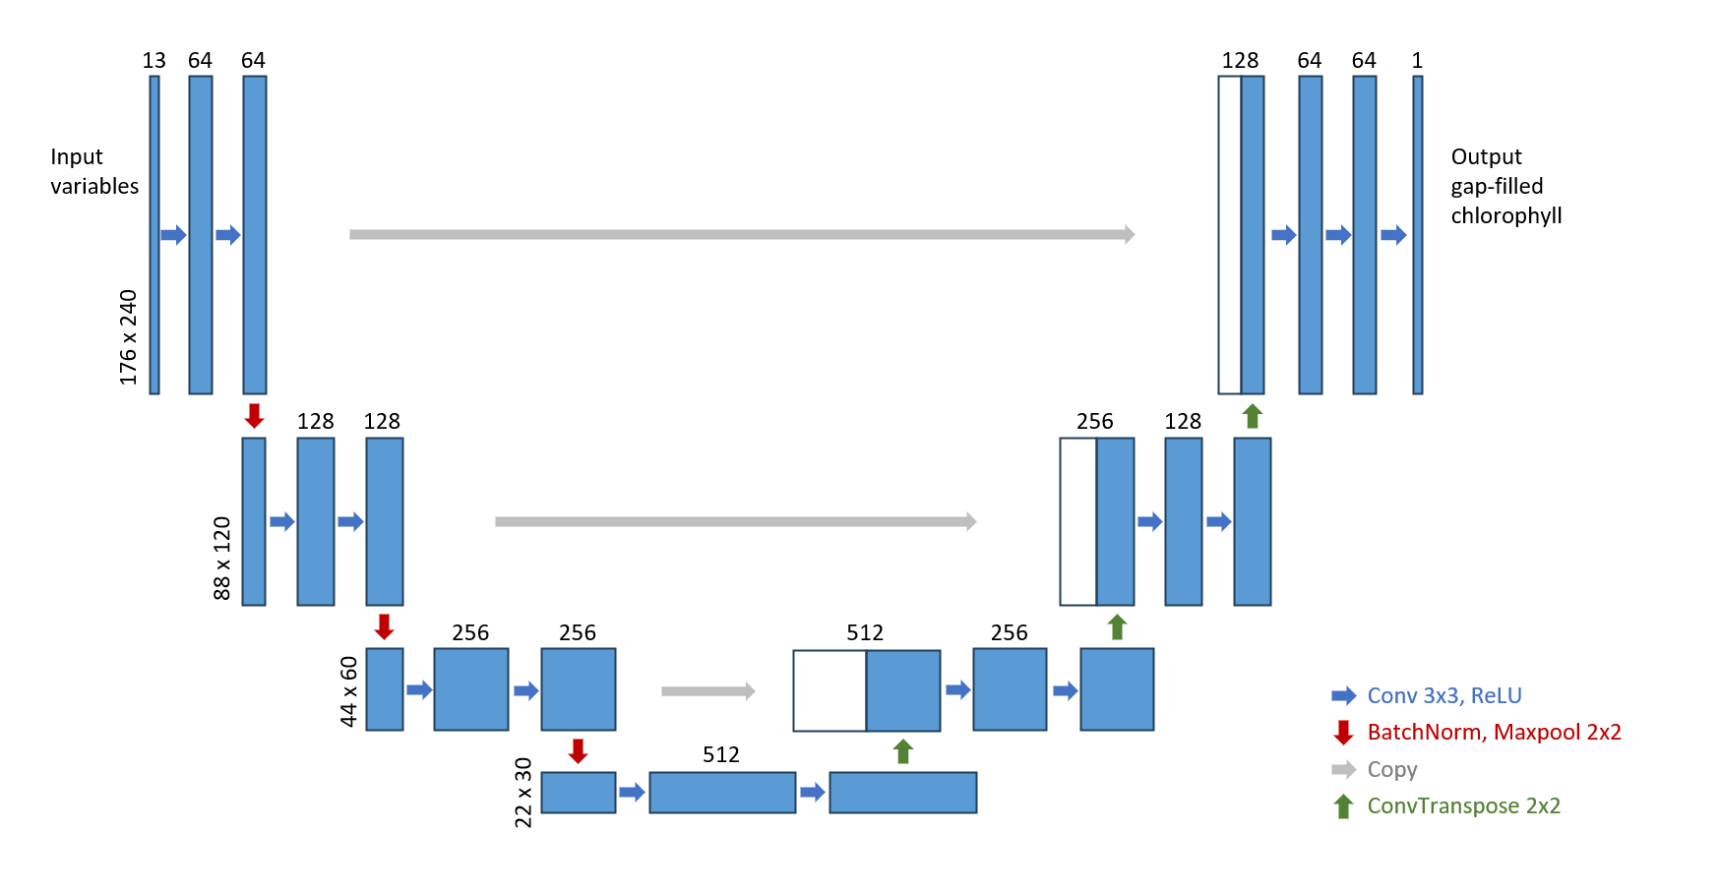
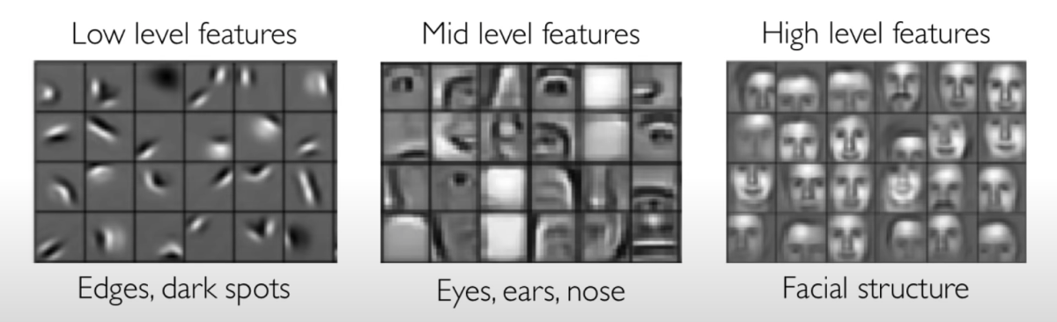
U-Net: A Convolutional Neural Network Architecture
Encoder: feature extraction with convolutional layers
Decoder: construct gap-filled image with extracted features

Slide 4
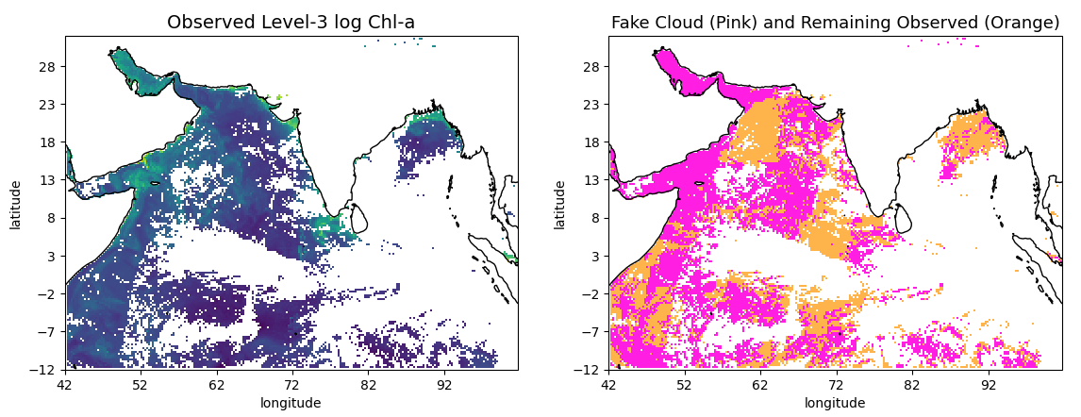
Variables & Data Processing
Data processing: mask observed chlorophyll with artificial clouds; log CHL; standardize; fill N/A with 0
Remaining observed in which the predictions were based on
Environmental variables: SST, air temp, winds, time
CHL info: current, prior day, latter day masked CHL
Flags: binary flags for land, fake cloud, real cloud, observed CHL
Evaluate prediction against the masked observed

Slide 5
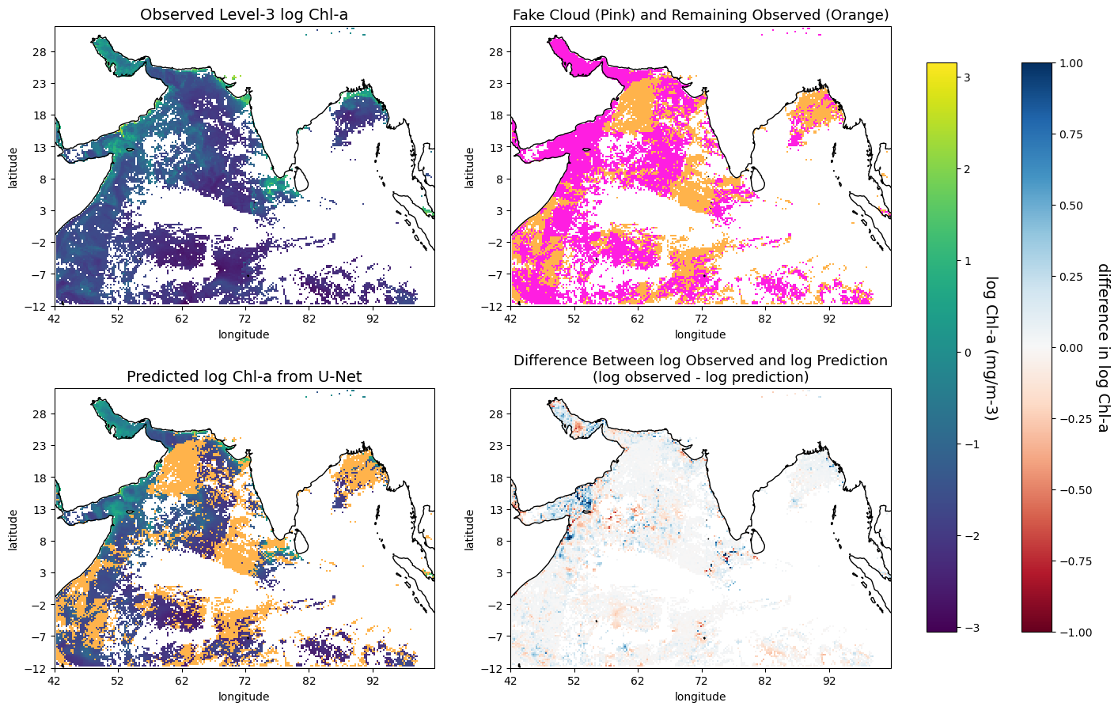
Testing Against Observed - Visual Example

Slide 6
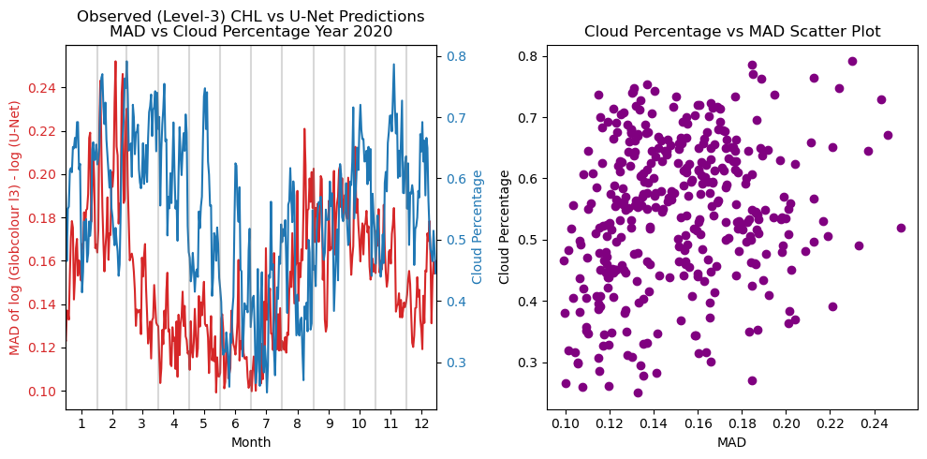
Testing Against Observed - Daily Mean Difference
Percentage difference

Slide 7
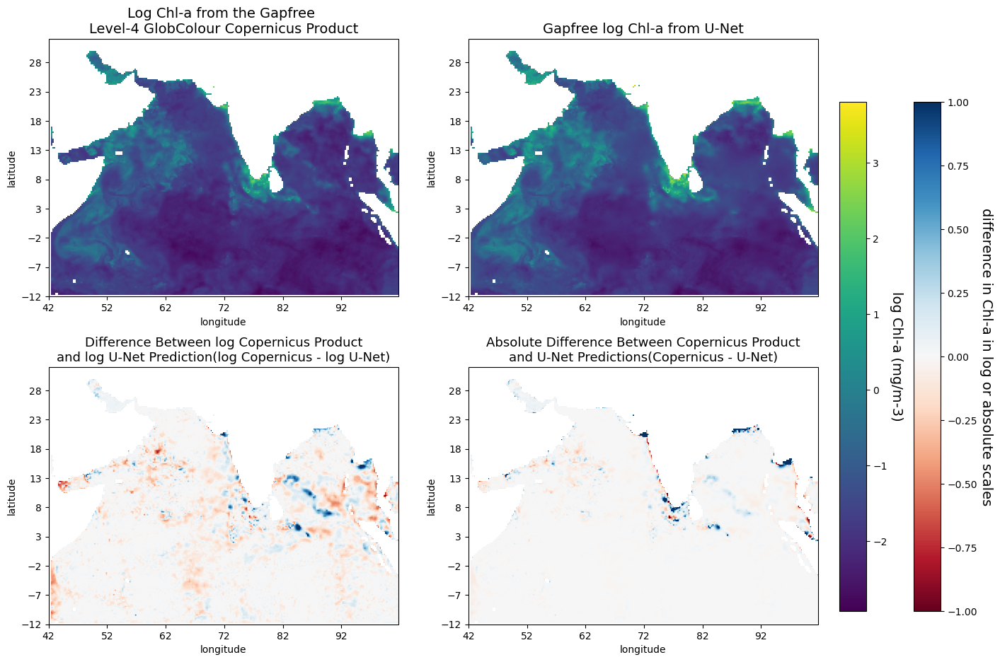
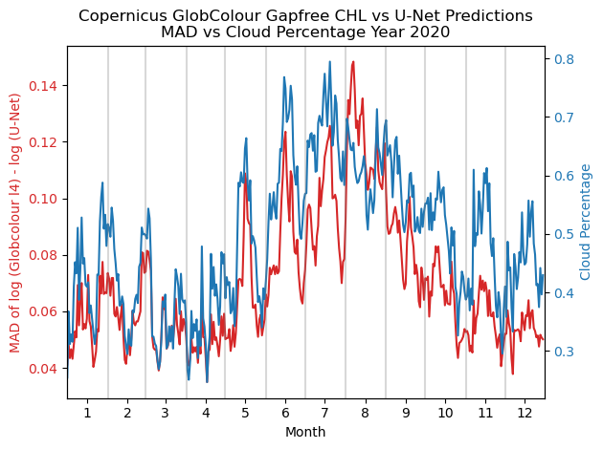
Compare Against Copernicus-GlobColour L4
Percentage difference

Slide 8
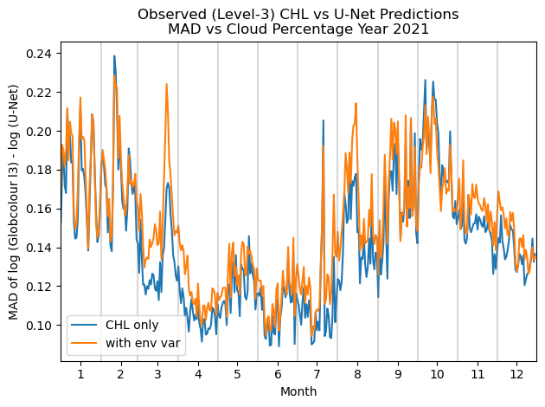
Does Environmental Variables Help?
Sadly, not really :(
Percentage difference

Slide 9
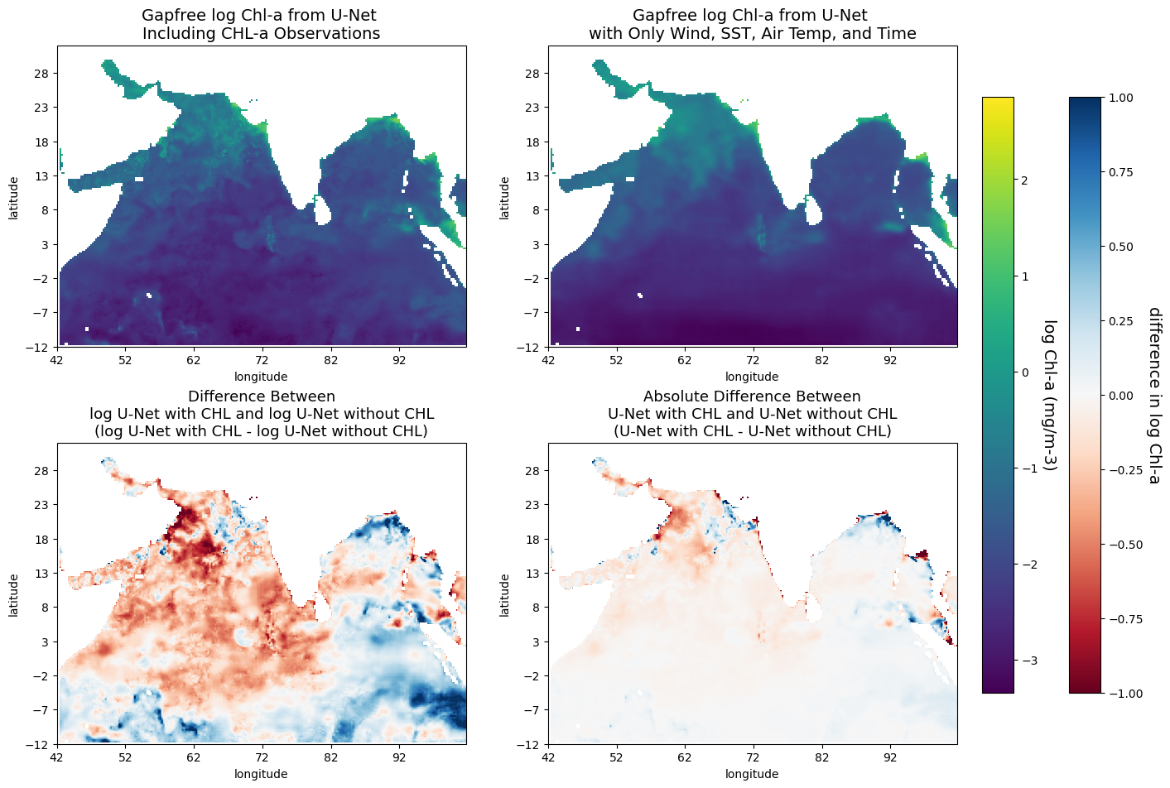
Are Environmental Variables Useful At All?
Yes!
Captures the general pattern
CAN reconstruct some details in certain regions

Slide 10
Main Takeaways
Initial model: work well, low mean absolute difference against the truth and similar to Level-4 product
Main difference with the Copernicus L-4 Gapfree product: lower coastline estimation
Environmental variables effectiveness: introduces noise with less missing chlorophyll; CAN capture chlorophyll patterns

